Slide 1

Classification of aviation noise
Project Pitch DL4AED
Lukas Probst, Jakob Tschavoll, Yijun Zhao
Dozenten: Fabian Seipel, Corvin Jaedicke
Wintersemester 2022

Slide 2
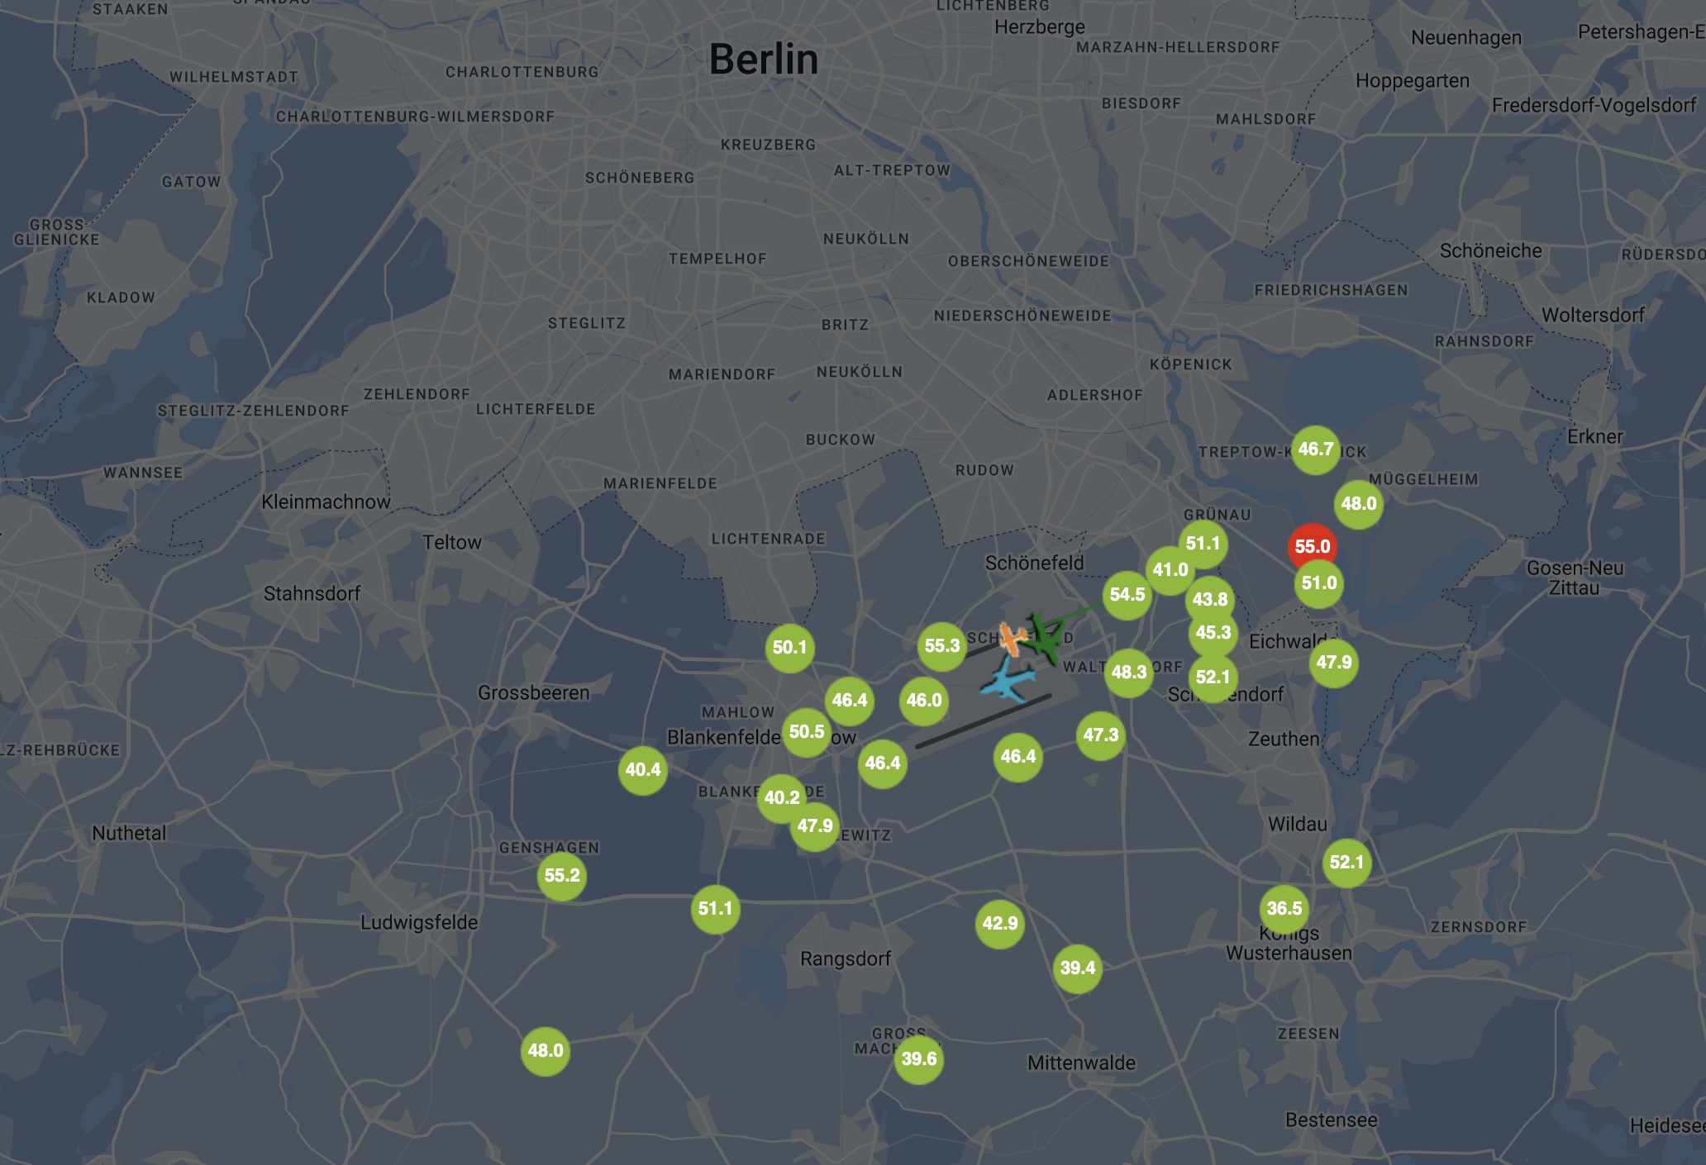
Project Motivation
Quelle: https://travisber.topsonic.aero

Slide 3
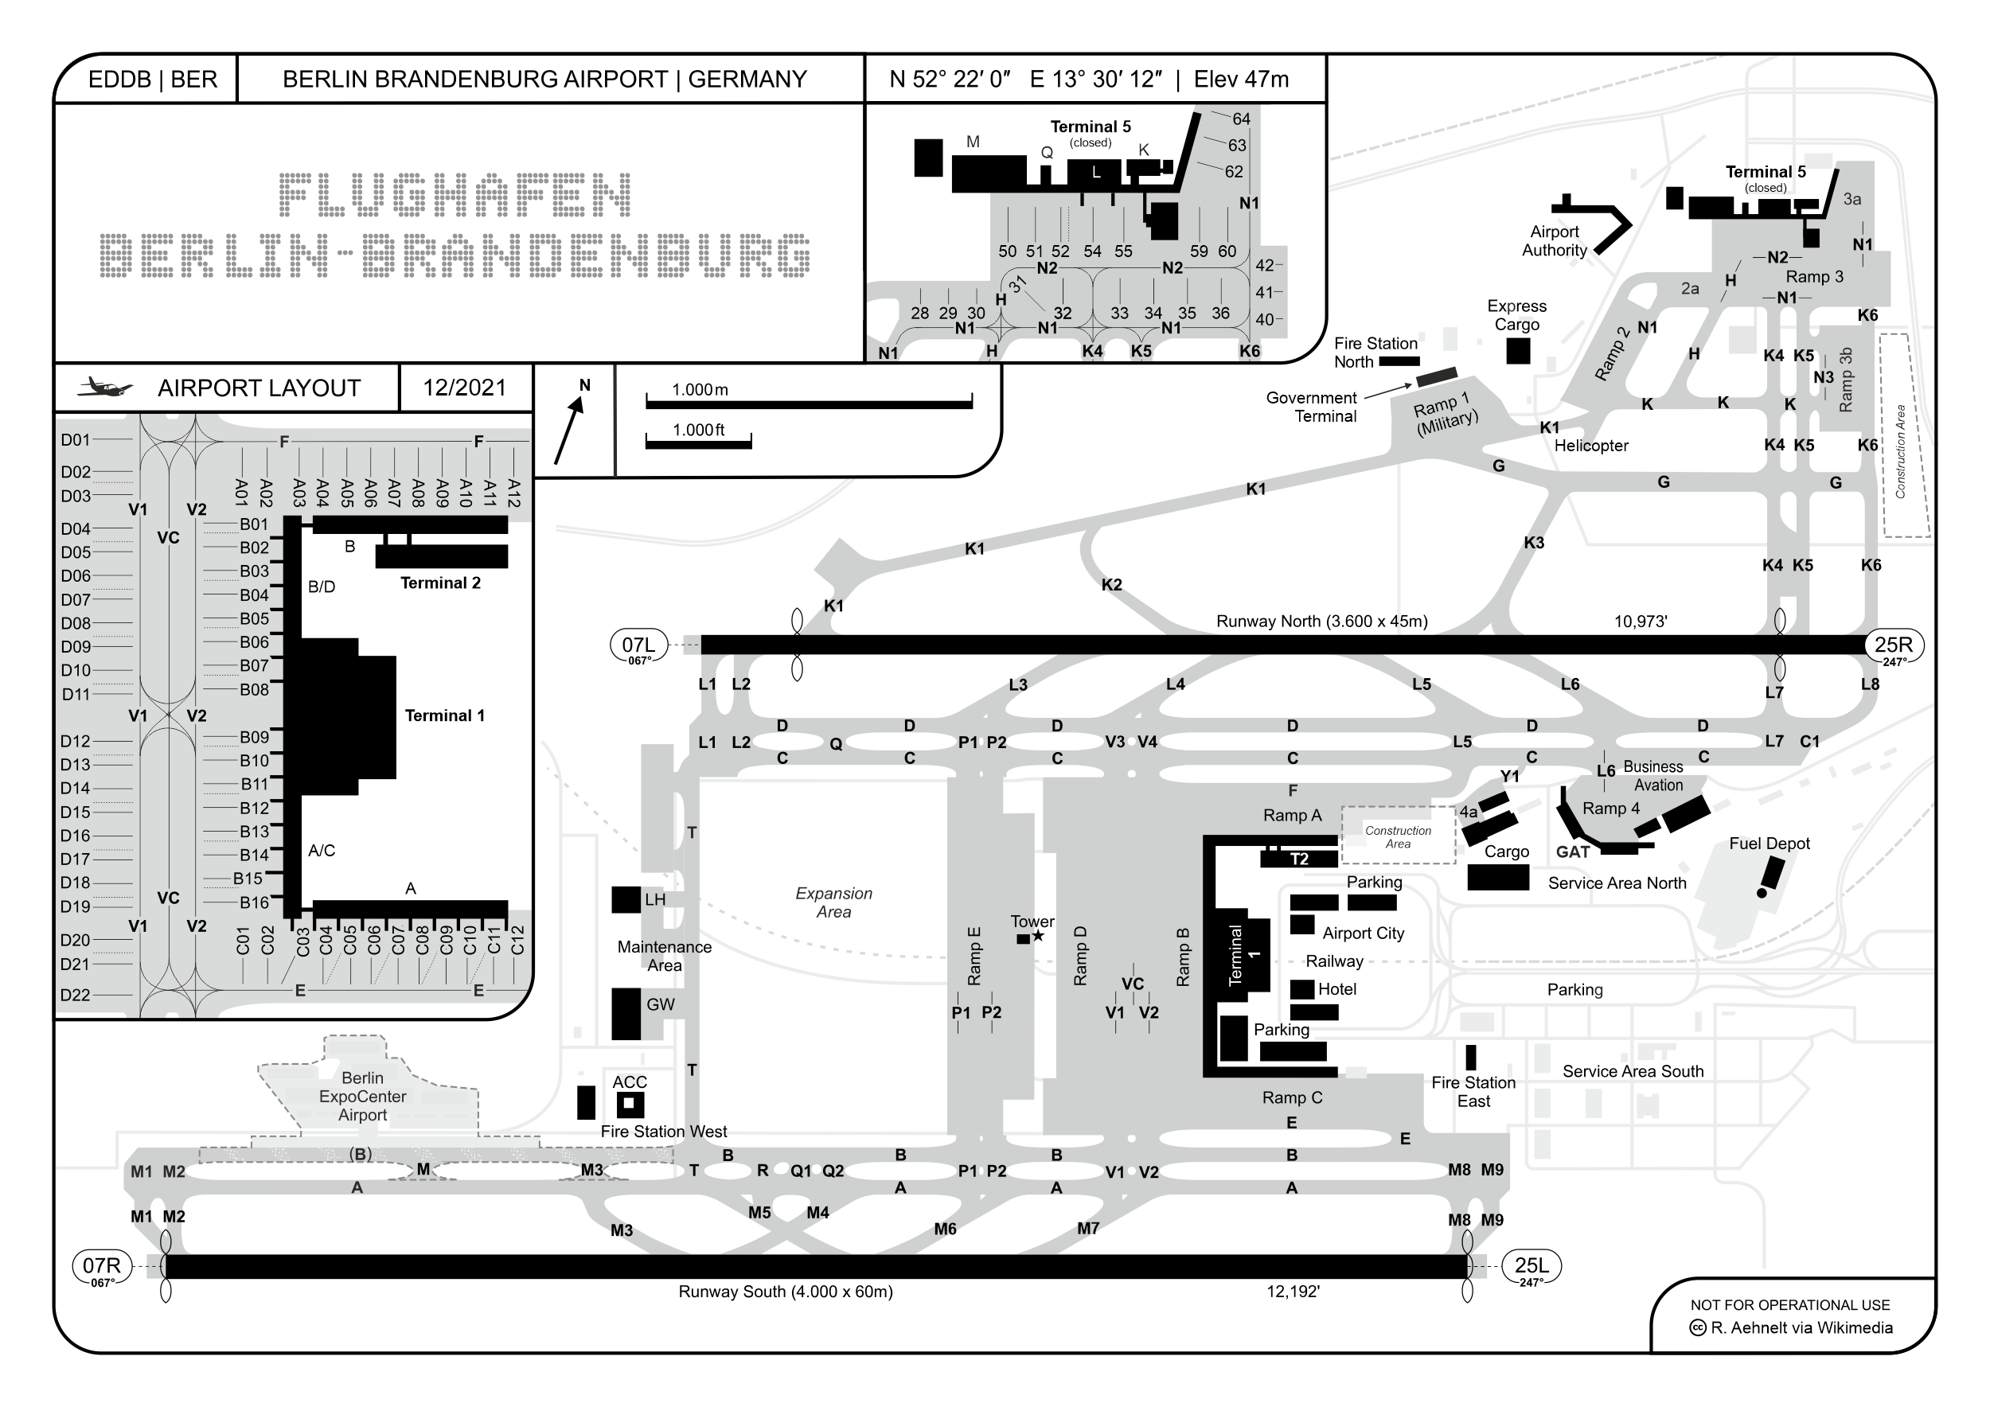
Project Motivation
Quelle: https://de.wikipedia.org/wiki/Flughafen_Berlin _Brandenburg#/media/Datei:EDDB_BER_Layout.png

Slide 4
Project Motivation
Problem to solve
Noise level monitoring of airports gets falsely triggered by non-aviation noise in the proximity of the measurement stations.
Strategic goal
Reduce the number of false triggers by classifying noise based on the presence of airplanes.

Slide 5
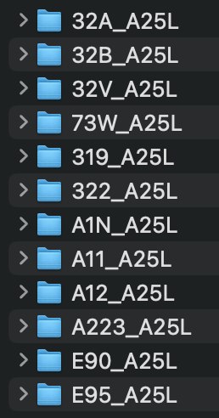
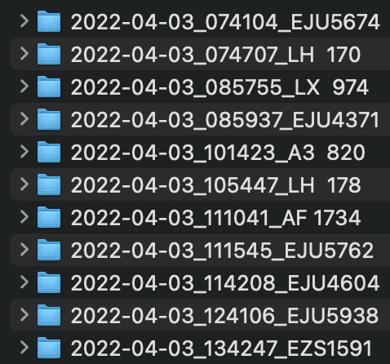
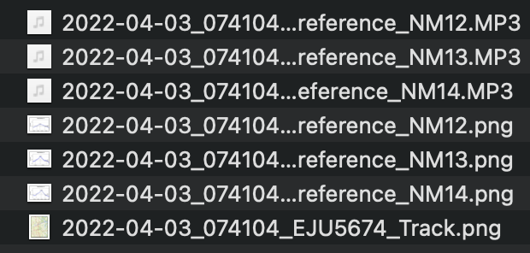
Problem Definition
What specific output do you want to predict?
Mixed or binary class (is_airplane, isnt_airplane) from sound files
Input Data / Training Data
80+ GB of mp3-airplane recordings: - 13 aviation types - 3 landing- and 2 start-runways - 60.000+ flight events - approx. 1.500 hours of audio - Location? - Dataset was provided by Airport BER

Slide 6
Performance Measurement
Expected Results
Simple benchmark to compare against
Run against YAMNet
Minimum level of accuracy expected
80%
What would a perfect solution look like?
Model that returns the amount of aviation noise that a noise contains

Slide 7
Milestones
Deadlines to be aware of
Project deadline
When do you need to see the first results?
Jan. 23
When do you want to have a finished solution?
Mar. 23

Slide 8
Contacts
Project Manager
TBD
Who can grant access to the datasets?
Airport BER
Who can help understand the current process and / or the simple benchmark?
?

Slide 9
Collaboration
Set up a weekly update with your team
TBD
Who should be involved?
Team members, course admins?, requesting company?
Define where code & issues are located and how to access them
Gitlab
How much compute power do you need and where can you get it?
Model and FE won't be too large, if resources get tight, use multiple google colab GPUs

